Slide 1
ONLINE ORDERING FOR UW DINING by Sanjana Kumar

Slide 2
Business problem
University of Washington's campus dining services is the main business or organization used for the database application being created.
The university has multiple dining locations with a variety of different cuisines across the campus.
Currently, the customers can go to the dining locations, stand in queue, and order their food.
If the preparation time is longer then the customers must wait till the time the food the prepared.

Slide 3
GOAL OF THE PROJECT
The goal of the project is to create a database that mainly focuses on providing information about all the restaurants on the campus allowing customers to order online.
Students, faculty and all the customers can order ahead and save time by browsing menus, placing orders, and paying online.
The customers have an option to pick up orders without waiting in the queue.
Multiple payment methods such as dining account, Husky card or credit card would be beneficial.
Overall, the aim is to enhance the dining experience on campus by providing convenient ordering process.

Slide 4
Entities that were identified
CUSTOMER | Represents individuals who visit or order from the restaurant.
FOOD_ITEMS | Represents the various dishes and items available on the restaurant's menu.
ORDER | Represents information about specific customer orders.
RESTAURANT | Represents the individual restaurants or dining locations.
INVENTORY | Represents the many-to-many relationship between restaurants and food items.
PAYMENT | Represents the various methods by which customers can make payments for their orders.
REVIEWS | Stores customer feedback and ratings for both the restaurant and specific food items.
FOOD_ITEM_TYPE | The type of food item for example beverage, fast food, etc.
EMPLOYEE | Represents the staff working at the restaurant.
EMPLOYEE_WORKPLACE | Represents the many-to-many relationship between restaurants and employees.
ORDERED_FOOD | Represents the many-to-many relationship between order and food items.

Slide 5
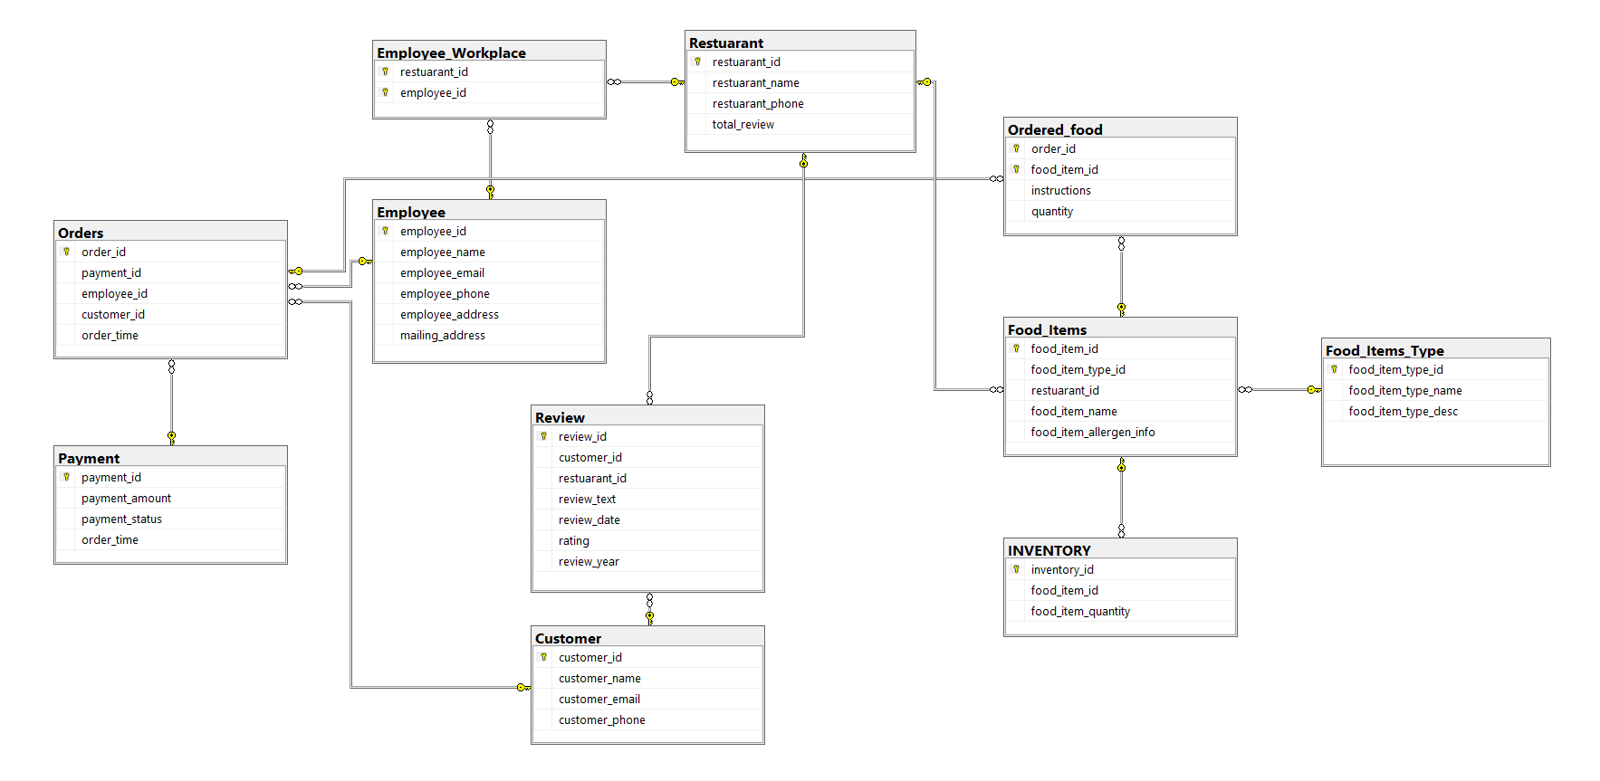
Revised er diagram

Slide 6
triggers
DDL/physical database design highlights

Slide 7
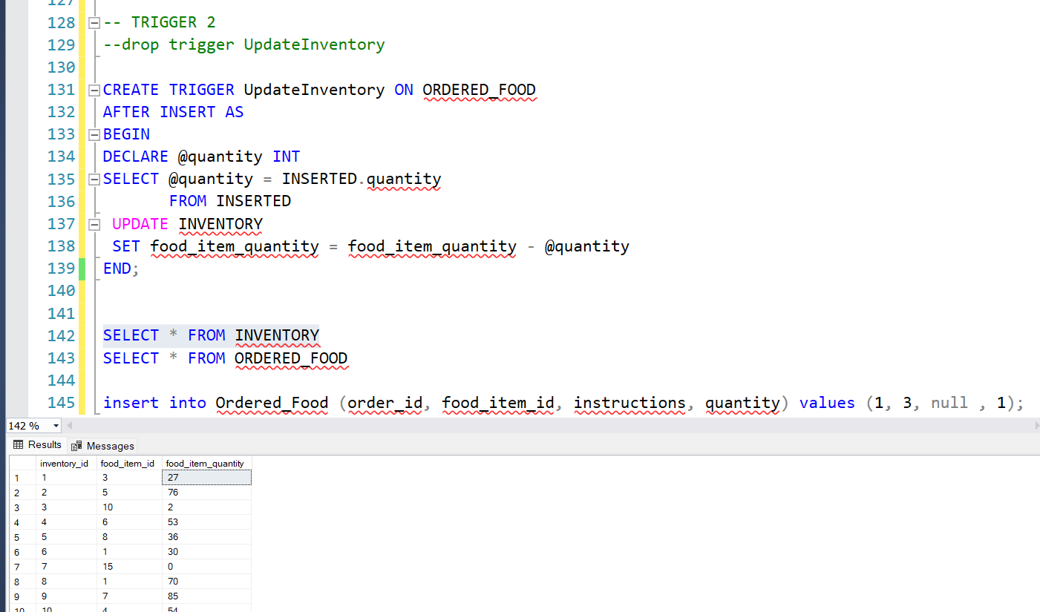
Trigger 1
When a food item is ordered it must be removed from the inventory. The trigger will help in automatically decreasing the food_item_quantity count in the inventory table when the trigger runs.

Slide 8
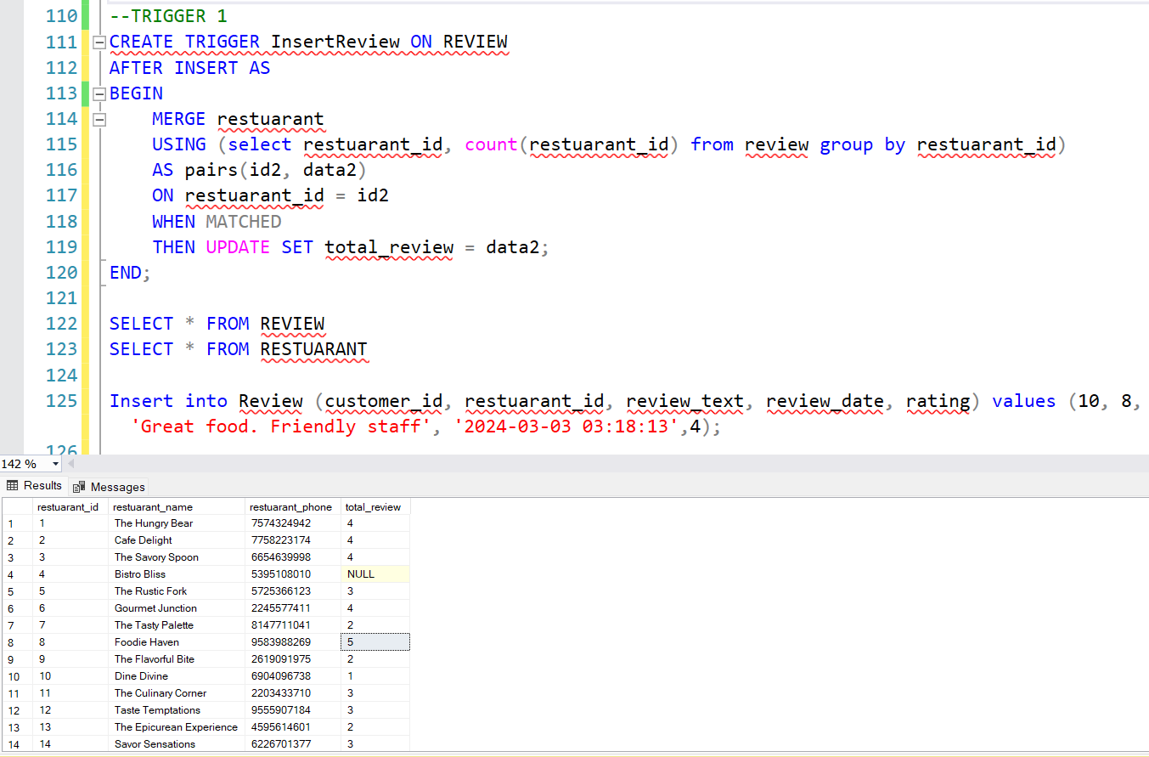
Trigger 2
Created a trigger to increase the count in the total_review column of the restaurant table which keeps count of the total reviews of a particular restaurant. This is triggered when a review is added in the review table.

Slide 9
Complex queries
Retrieving data from the database (SQL)

Slide 10
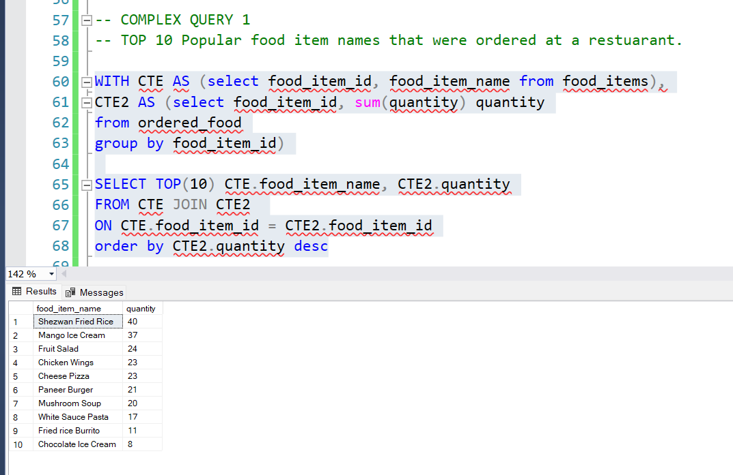
Complex query 1
Top 10 Popular food item names that were ordered at a restaurant.

Slide 11
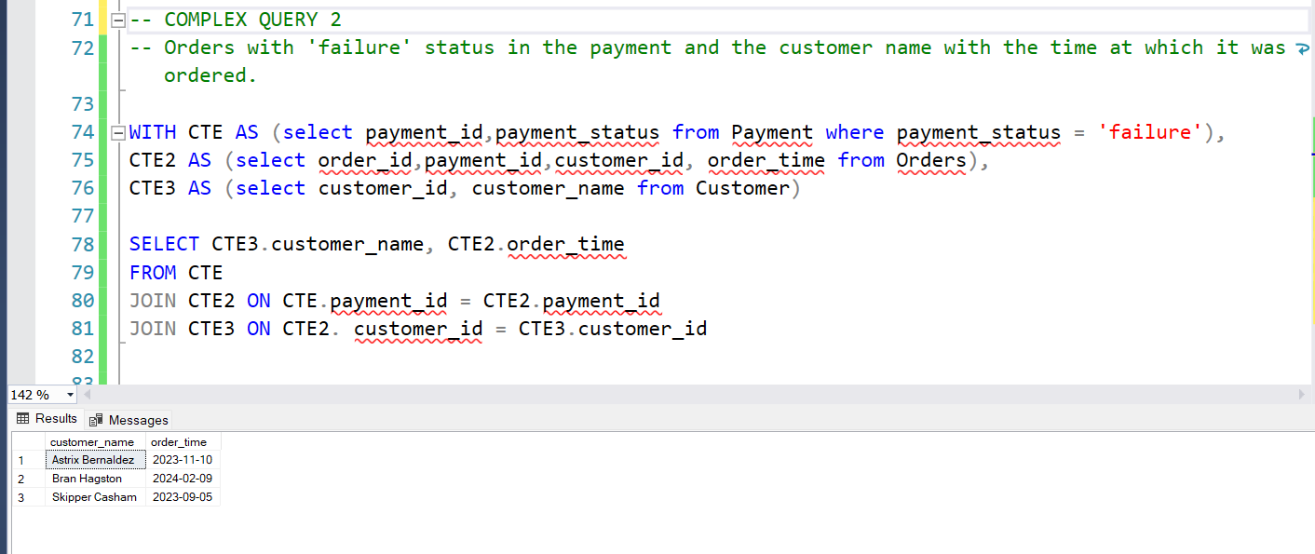
Complex query 2
Order with “failure” status in the payment retrieved along with customer's name with the time at which it was ordered.

Slide 12
Thank you

